Slide 1

Rapport de stage de fin d’étude à Deloitte
Luxembourg
Sujet de mémoire : Modélisation des Taux d’Intérêts
Instantanés pour la Valuation des
Produits Dérivés Obligataires
17 juin - 29 Novembre 2024
Jiaqi Xia
07/10/2024

Slide 2
Contents
Présentation Générale du Stage
Introduction au sujet de mémoire
Développement - Modélisation des Taux d’Intérêts Instantanés
Développement - Application à la valorisation des Callable Bonds
Développement - Calcul du SCR de Marché
Conclusion
Autres Activités effectués pendant le stage
Annexes

Slide 3
Présentation Générale du Stage
Poste : Stagiaire pour le développement quantitatif
Durée : 24 semaines (17 juin 2024 à 29 novembre 2024)
Firme : Deloitte Tax & Consulting
Équipe : Institutional Investors R

Slide 4
Introduction au sujet de mémoire
Présentation des modèles classiques
Proposition de nouveau modèle : Hidden Markov Constant Elasticity of Volatility (HMCEV)
Étapes de calibration
Analyse des performances

Slide 5
Modélisation des Taux d’Intérêts Instantanés
Présentation des modèles classiques
Proposition de nouveau modèle : Hidden Markov Constant Elasticity of Volatility (HMCEV)
Étapes de calibration
Analyse des performances

Slide 6
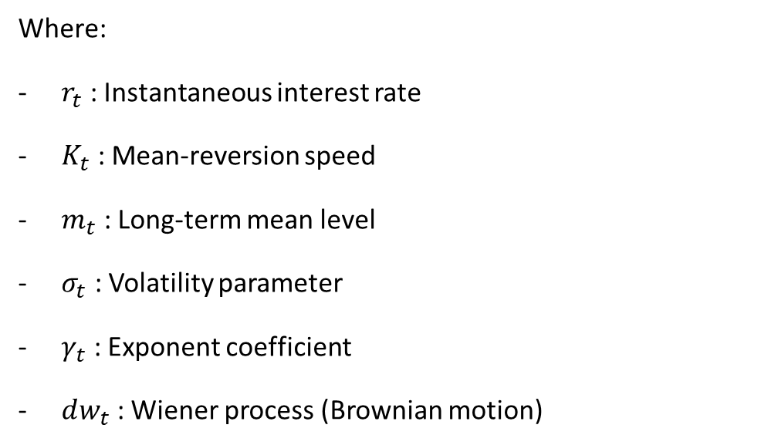
Mean reverting diffusion models with stochastic volatility :
A general family of models
The general standard stochastic differential equation (SDE) for this family of models is:
$$d_{r_{t}}=K_{t}\left(m_{t} −r_{t}\right)dt+ {σ_{t}r}_{t}^{γ_{t}}dw_{t}$$
Where:
$r_{t}$​ : Instantaneous interest rate
$K_{t}$ : Mean-reversion speed
$m_{t}$ : Long-term mean level
$σ_{t}$ : Volatility parameter
$γ_{t}$ : Exponent coefficient
$dw_{t}$ : Wiener process (Brownian motion)
All these parameters are time dependent and could have their own dynamic.

Slide 7

Classical Existing Instantaneous rate models
Some specific cases of the mean reverting diffusion models. In addition, for all existing models we use $​​{\left|r_{t}\right|}^{β}$ instead of $​​r_{t}^{β}$ to allow negative interest rates.
Scaled Brownian motion
$$d_{r_{t}}= σdw_{t}$$
Vasicek
$d_{r_{t}}=K\left(m −r_{t}\right)dt+ σdw_{t}$
D_
CIR (Cox-Ingersoll-Ross)
$$d_{r_{t}}=K\left(m −r_{t}\right)dt+ σ{\left|r_{t}\right|}^{0.5}dw_{t}$$
CEV(Constant elasticity of Variance)
$$d_{r_{t}}=K\left(m −r_{t}\right)dt+ σ{\left|r_{t}\right|}^{γ}dw_{t}$$
three-factor model of Anderson & Lund
$$d_{r_{t}}=K_{1}\left(m_{t} −r_{t}\right)dt+σ{\left|r_{t}\right|}^{γ}dw_{1,t}$$
$$d_{\log{σ_{t}^{2}}}=K_{2}\left(α −\log{σ_{t}^{2}}\right)dt+ ε_{1}dw_{2,t}$$
$$d_{m_{t}}=K_{3}\left( θ−m_{t}\right)dt+ ε_{2}{\left|m_{t}\right|}^{0.5}dw_{3,t}$$

Slide 8
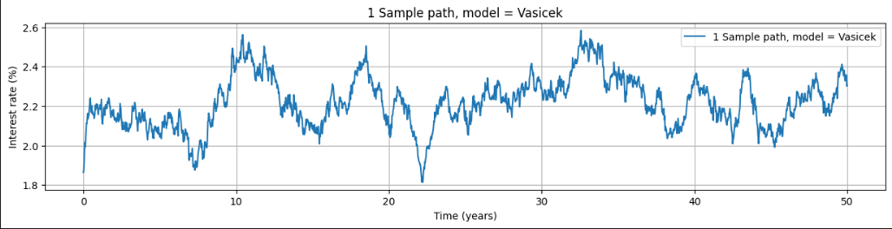
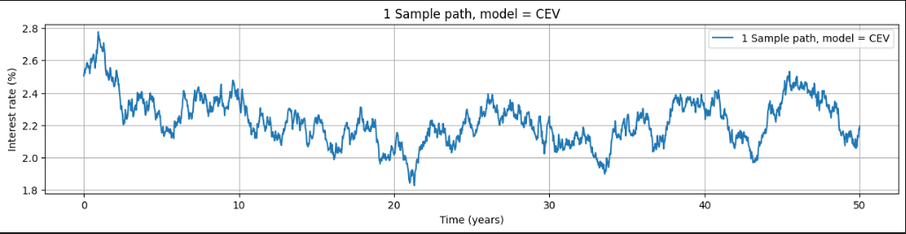
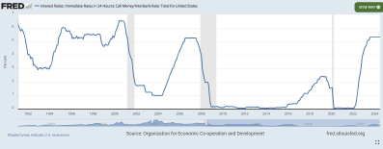
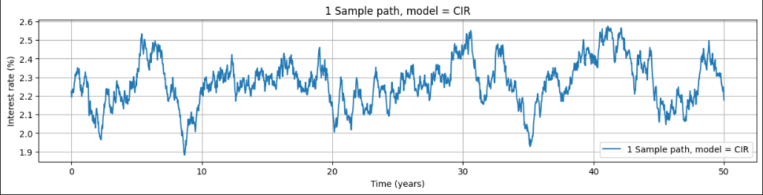
Favourable scenario

Slide 9
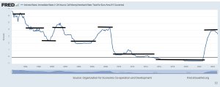
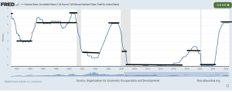
Stylized facts

Slide 10
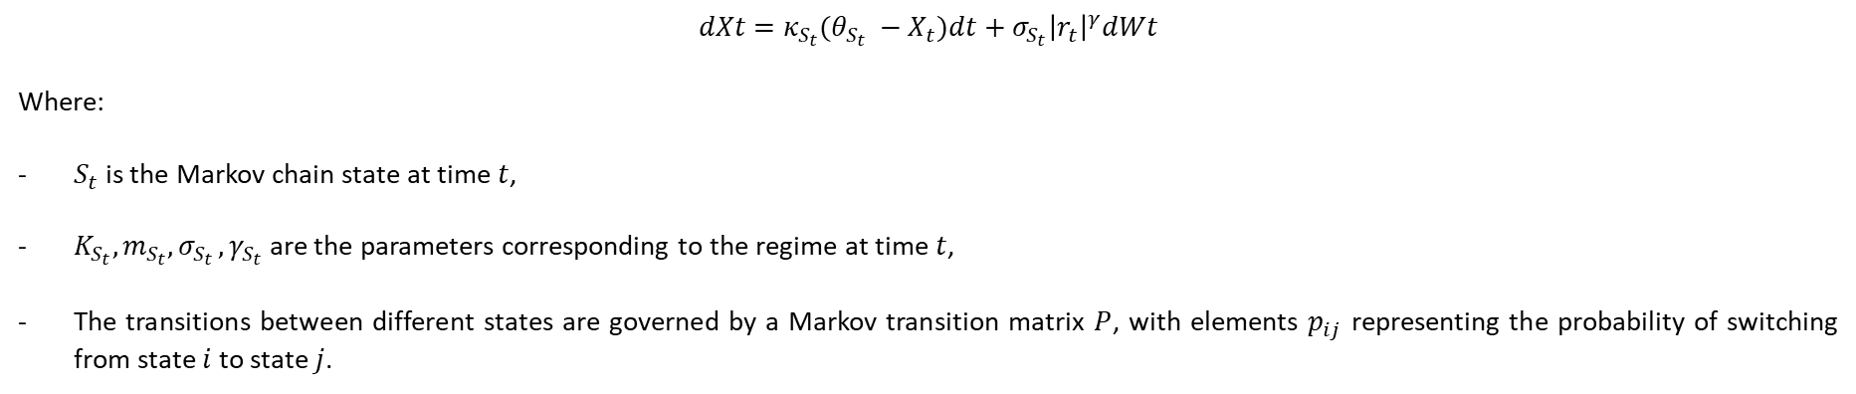
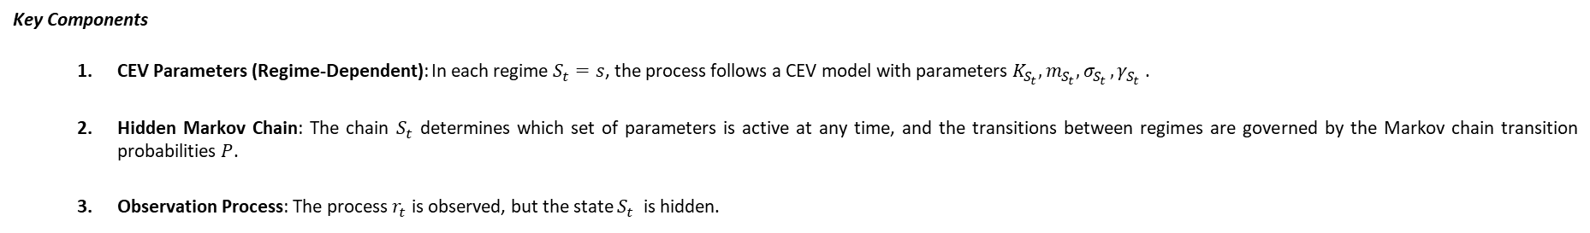
Hidden Markov CEV model (HMCEV)
In the Hidden Markov CEV model, the parameters of the CEV model (K$,m,σ, β$) are assumed to change according to a hidden Markov chain. This allows the model to capture regime-switching behavior, where the process can transition between different states, each with its own set of parameters.
$$dXt​=κ_{S_{t}}​(θ_{S_{t}} ​​−X_{t}​)dt+σ_{S_{t}}​​{\left|r_{t}\right|}^{γ}dWt​$$
Where:
$S_{t}$​ is the Markov chain state at time $t$,
$K_{S_{t}}​​,m_{S_{t}}​​,σ_{S_{t }},γ_{S_{t}}$​​ are the parameters corresponding to the regime at time $t$,
The transitions between different states are governed by a Markov transition matrix $P$, with elements $p_{ij}$​ representing the probability of switching from state $i$ to state $j$.
Key Components
CEV Parameters (Regime-Dependent): In each regime $S_{t}=s$, the process follows a CEV model with parameters $K_{S_{t}}​​,m_{S_{t}}​​,σ_{S_{t }},γ_{S_{t}}$ .
Hidden Markov Chain: The chain $S_{t}$​ determines which set of parameters is active at any time, and the transitions between regimes are governed by the Markov chain transition probabilities $P$.
Observation Process: The process $r_{t}$​ is observed, but the state $S_{t}$ ​ is hidden.

Slide 11
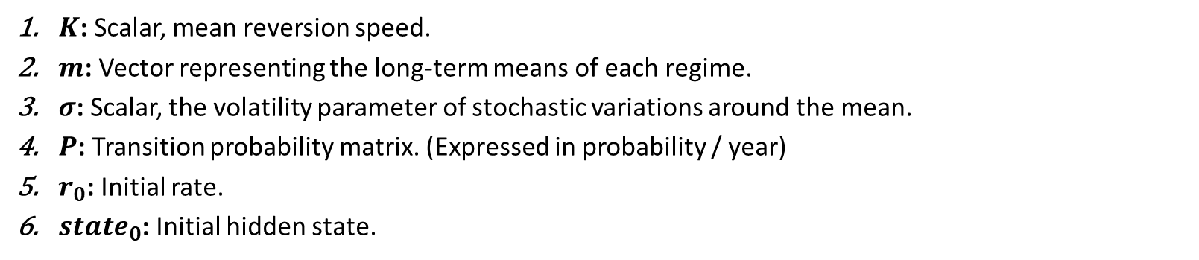
HMCEV
HMCIR Parameters
In our case : For simplification, since we observe the most notable parameter that seem to vary according to regime it the long-term average $m_{S_{t}}$ ,we suppose that $K_{S_{t}}​​ ​​,σ_{S_{t }},γ_{S_{t}}$ are the same for all regimes
Finally, we have
$K$: Scalar, mean reversion speed.
$m$: Vector representing the long-term means of each regime.
$σ$: Scalar, the volatility parameter of stochastic variations around the mean.
$P$: Transition probability matrix. (Expressed in probability / year)
$r_{0}$: Initial rate.
$state_{0}$: Initial hidden state.

Slide 12
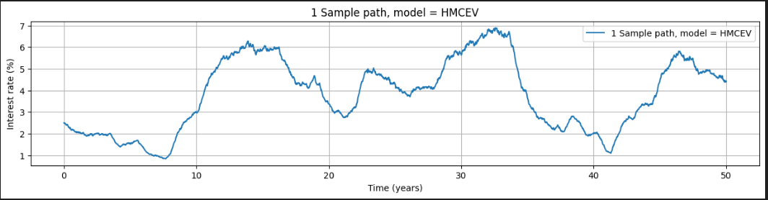
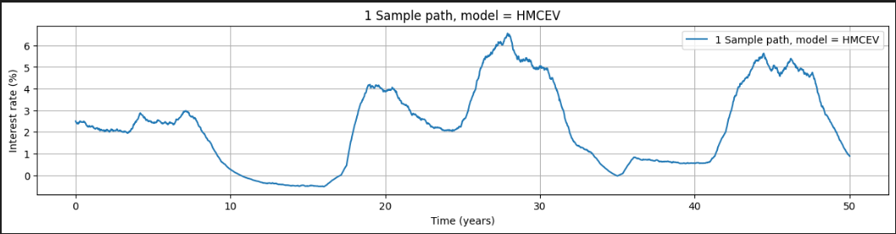

HMCEV
Interest rate paths simulation
By discretizing the HMCIR SDE, after fixing an initial rate and state, we simulate paths of $n+1$steps over a time of $T$ years. ( $Δt=\frac{T}{n}$)
$$r_{t_{i+1}}=r_{t_{i}}+κ_{S_{t_{i}}}\left(θ_{S_{t_{i}}}−r_{t}\right)Δt+σ_{S_{t_{i}}}{\left|r_{t_{i}}\right|}^{γ}𝒩\left(0,1\right)Δt^{0.5}$$
The hidden state is not updated each step, but only a certain number $n_rev$ per year with the matrix $P^{\left( \frac{1}{n_{rev}} \right)}$
The whole process is vectorialized to simulate $N$ paths in parallel.
Image of large number of paths

Slide 13

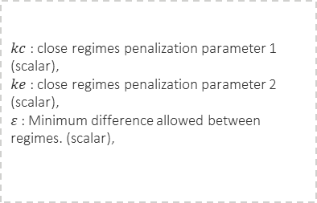
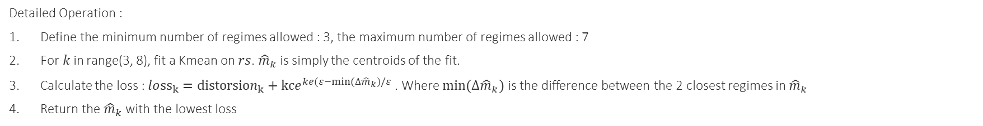

Model Calibration HMCEV
m-Estimator Module
Category II
Input
Hyperparameters
Output
Purpose
-$rs$ : resampled rates (array)
$kc$ : close regimes penalization parameter 1 (scalar),
$ke$ : close regimes penalization parameter 2 (scalar),
$ε$ : Minimum difference allowed between regimes. (scalar),
$\hat{m}$ : estimated m (array)
Estimate the means of different regimes in the HMCIR model using K-means clustering.
Aims to minimize distortion while penalizing the existence of regimes that are too close.
Detailed Operation :
Define the minimum number of regimes allowed : 3, the maximum number of regimes allowed : 7
For$k$in range(3, 8), fit a Kmean on $rs$. ${\hat{m}}_{k}$ is simply the centroids of the fit.
Calculate the loss : $lo{ss}_{k}={distorsion}_{k}+kce^{ke(ε−min⁡(∆{\hat{m}}_{k})/ε}$ . Where $min⁡(∆{\hat{m}}_{k})$ is the difference between the 2 closest regimes in ${\hat{m}}_{k}$
Return the ${\hat{m}}_{k}$ with the lowest loss
K-means clustering is an unsupervised machine learning algorithm that groups similar data points into K distinct clusters. The algorithm wants to minimize the distance between data points within the same cluster and maximize the distance between data points in different clusters. K-Means Algorithm (with example). Introduction | by Lea Setruk | Medium

Slide 14
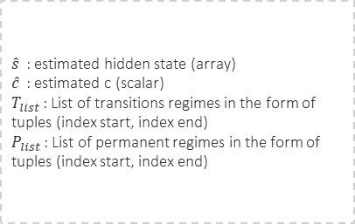
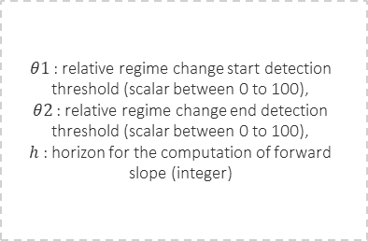
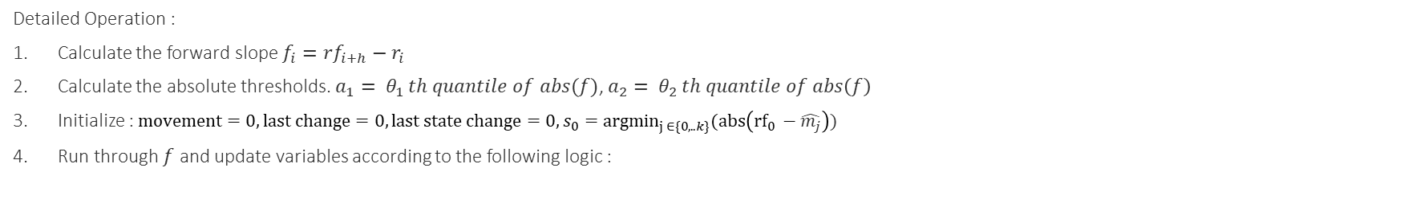

Model Calibration HMCEV
Hidden state estimation Module
Category II
Input
Hyperparameters
Output
Purpose
- $rf$: filtered rates (array)
- $\hat{m}$ : estimated m (array)
$θ1$ : relative regime change start detection threshold (scalar between 0 to 100),
$θ2$ : relative regime change end detection threshold (scalar between 0 to 100),
$h$ : horizon for the computation of forward slope (integer)
$\hat{s}$ : estimated hidden state (array)
$\hat{c}$ : estimated c (scalar)
$T_{list}$ : List of transitions regimes in the form of tuples (index start, index end)
$P_{list}$ : List of permanent regimes in the form of tuples (index start, index end)
Estimate the hidden state at each step, count the number of regime switch and give the list of transition regimes (When the regime just switched, and the rates are evolving toward the mean of the new regime) and permanent regime. (when the rates reached the neighborhoods of the new regime means and evolve near it)
Detailed Operation :
Calculate the forward slope $f_{i}={rf}_{i+h}−r_{i}$
Calculate the absolute thresholds. $a_{1}= θ_{1 }th quantile of abs(f)$, $a_{2}= θ_{2 }th quantile of abs\left(f\right)$
Initialize : $movement=0, last change=0, last state change=0, s_{0}={argmin}_{j ∈\{0,..k\}}(abs\left({rf}_{0} −\hat{m_{j}}\right))$
Run through $f$ and update variables according to the following logic :

Slide 15
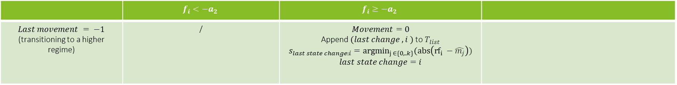
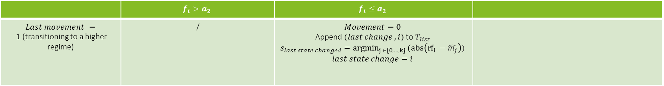
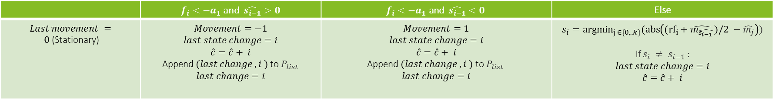
Model Calibration HMCEV
Hidden state estimation Module
Category II
Update logic
 | $$f_{i}<−a_{2}$$ | $$f_{i}≥−a_{2}$$
$Last movement = −1$ (transitioning to a higher regime) | / | $$Movement=0$$ Append $(last change ,i )$to $T_{list}$ $$s_{last state change:i}={argmin}_{j ∈\{0,..k\}}(abs\left({rf}_{i} −\hat{m_{j}}\right))$$ $$last state change=i$$
 | $$f_{i}>a_{2}$$ | $$f_{i}≤a_{2}$$
$Last movement = 1$(transitioning to a higher regime) | / | $$Movement=0$$ Append $(last change ,i)$to $T_{list}$ $$s_{last state change:i}={argmin}_{j ∈\{0,…,k\} }(abs\left({rf}_{i} −\hat{m_{j}}\right))$$ $$last state change=i$$
 | $f_{i}<−a_{1}$ and $\hat{s_{i−1}}>0$ | $$f_{i}<−a_{1} \text{and} \hat{s_{i−1}}<0$$ | Else
$Last movement = 0$(Stationary) | $$Movement=−1$$ $$last state change=i$$ $$\hat{c}=\hat{c}+ i$$ Append $(last change ,i )$to $P_{list}$ $$last change=i$$ | $$Movement=1$$ $$last state change=i$$ $$\hat{c}=\hat{c}+ i$$ $$\text{Append} (last change ,i ) \text{to} P_{list}$$ $$last change=i$$ | $$s_{i}={argmin}_{j ∈\{0,..k\}}(abs\left(({rf}_{i}+\hat{m_{\hat{s_{i−1 }}}})/2 −\hat{m_{j}}\right))$$ If $s_{i} ≠ s_{i−1 }:$ $$last state change=i$$ $$\hat{c}=\hat{c}+ i$$

Slide 16
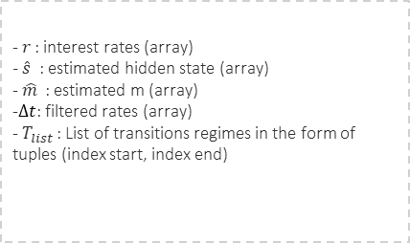
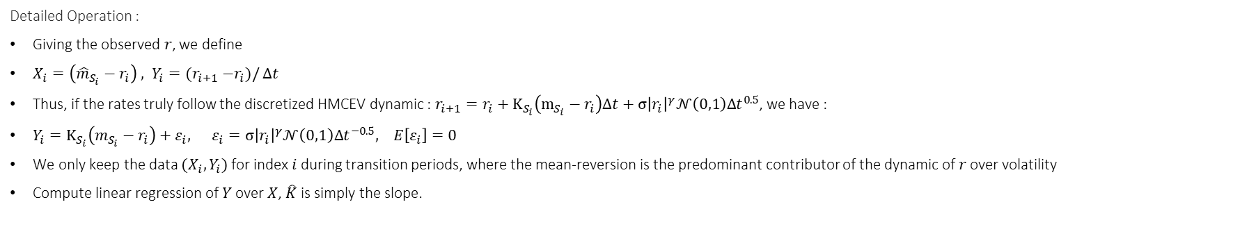


Model Calibration HMCEV
$K$ estimation Module
Category II
Input
Hyperparameters
Output
Purpose
-$r$ : interest rates (array)
$− \hat{s}$ : estimated hidden state (array)
- $\hat{m}$ : estimated m (array)
-$Δt$: filtered rates (array)
- $T_{list}$ : List of transitions regimes in the form of tuples (index start, index end)
$\hat{K}$ : estimated m (array)
Estimate the mean-reversion speed ($K$) of the HMCIR model.
Detailed Operation :
Giving the observed $r$, we define
$X_{i}=\left({\hat{m}}_{S_{i}}−r_{i}\right) , Y_{i}={(r}_{i+1} −r_{i})/$ $Δt$
Thus, if the rates truly follow the discretized HMCEV dynamic : $r_{i+1}=r_{i}+K_{S_{i}}\left(m_{S_{i}}−r_{i}\right)Δt+σ{\left|r_{i}\right|}^{γ}𝒩\left(0,1\right)Δt^{0.5}$, we have :
$Y_{i}=K_{S_{i}}\left(m_{S_{i}}−r_{i}\right)$ $+ ε_{i}, ε_{i}=σ{\left|r_{i}\right|}^{γ}𝒩\left(0,1\right)Δt^{−0.5}, E\left[ε_{i}\right]=0$
We only keep the data $(X_{i}, Y_{i})$ for index $i$ during transition periods, where the mean-reversion is the predominant contributor of the dynamic of $r$ over volatility
Compute linear regression of $Y$ over $X$, $\hat{K}$ is simply the slope.

Slide 17
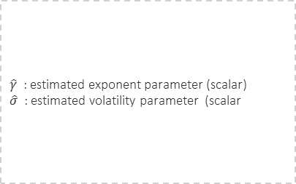
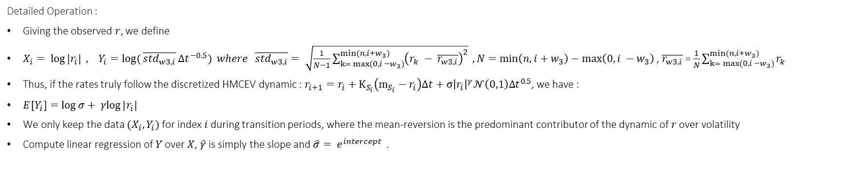
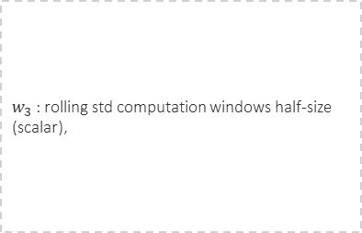

Model Calibration HMCEV
$β$and $σ$ estimation Module
Category II
Input
Hyperparameters
Output
Purpose
-$r$ : interest rates (array)
$− \hat{s}$ : estimated hidden state (array)
- $\hat{m}$ : estimated m (array)
-$Δt$: filtered rates (array)
- $P_{list}$ : List of transitions regimes in the form of tuples (index start, index end)
$w_{3}$ : rolling std computation windows half-size (scalar),
$\hat{γ}$ : estimated exponent parameter (scalar)
$\hat{σ}$ : estimated volatility parameter (scalar
Estimate the exponent and volatility parameters of the HMCIR model.
Detailed Operation :
Giving the observed $r$, we define
$X_{i}= \log{|r_{i}|} , Y_{i}=log⁡({\overline{std_{w3, i}}}Δt^{−0.5}) where \overline{std_{w3, i}}= \sqrt{\frac{1}{N−1}\sum_{k= max⁡(0, i −w_{3})}^{min⁡(n, i+w_{3})}{{\left(r_{k} − \overline{r_{w3, i}}\right)}^{2}}} ,N=\min\left(n, i+w_{3}\right)−\max\left(0, i −w_{3}\right)$ , $\overline{r_{w3, i}}$ = $\frac{1}{N}\sum_{k= max⁡(0, i −w_{3})}^{min⁡(n, i+w_{3})}{r_{k}}$
Thus, if the rates truly follow the discretized HMCEV dynamic : $r_{i+1}=r_{i}+K_{S_{i}}\left(m_{S_{i}}−r_{i}\right)Δt+σ{\left|r_{i}\right|}^{γ}𝒩\left(0,1\right)Δt^{0.5}$, we have :
${E[Y}_{i}]=\log{σ}+ γlog{|r_{i}|}$
We only keep the data $(X_{i}, Y_{i})$ for index $i$ during transition periods, where the mean-reversion is the predominant contributor of the dynamic of $r$ over volatility
Compute linear regression of $Y$ over $X$, $\hat{γ}$ is simply the slope and $\hat{σ}= e^{intercept}$ .

Slide 18

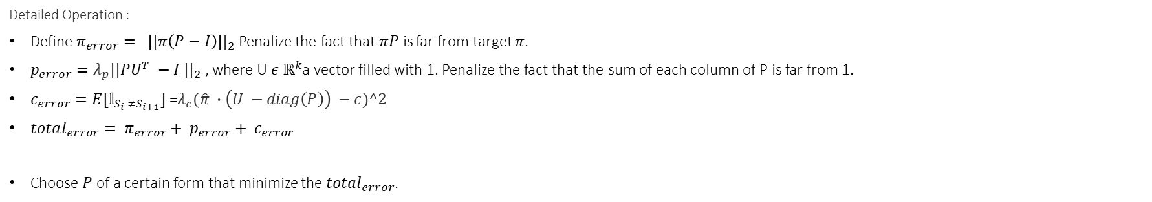
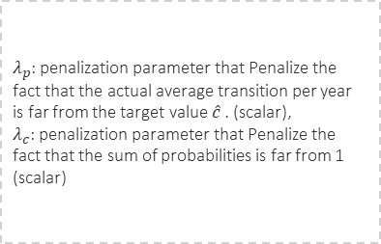
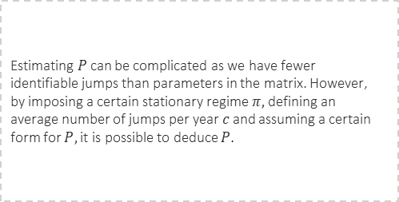
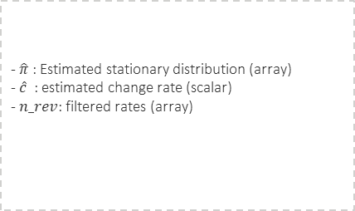
Model Calibration HMCEV
Compute P Module
Category II
Input
Hyperparameters
Output
Purpose
-$\hat{π}$ : Estimated stationary distribution (array)
-$\hat{c}$ : estimated change rate (scalar)
- $n_rev$: filtered rates (array)
$λ_{p}$: penalization parameter that Penalize the fact that the actual average transition per year is far from the target value $\hat{c}$. (scalar),
$λ_{c}$: penalization parameter that Penalize the fact that the sum of probabilities is far from 1 (scalar)
${\hat{P}}^{1/n_rev}$ : estimated transition matrix(matrix)
Estimating $P$can be complicated as we have fewer identifiable jumps than parameters in the matrix. However, by imposing a certain stationary regime $π,$defining an average number of jumps per year $c$and assuming a certain form for $P,$it is possible to deduce $P$.
Detailed Operation :
Define $π_{error}= {\left||π\left(P−I\right)\right||}_{2}$ Penalize the fact that $πP$ is far from target $π$.
$p_{error}=λ_{p}||PU^{T} −I |{\left.​\right|}_{2}$ , where U$ε ℝ^{k}$a vector filled with 1. Penalize the fact that the sum of each column of P is far from 1.
$c_{error}=E[𝕝_{S_{i} ≠S_{i+1}}]$ =$λ_{c}(\hat{π} ∙\left(U −diag\left(P\right)\right) −c)^2$
$total_{error}= π_{error}+ p_{error}+ c_{error}$
Choose $P$ of a certain form that minimize the $total_{error}$.

Slide 19


Model Calibration HMCEV
Compute P Module
Category II
How to compute $P$
The constraints on $\left(P\right)$ are:
The sum of each row is 1:
$\left(s\right)$ is the stationary distribution of the Markov chain:
In the stationary regime, the probability of transition per step is $\left(c\right)$:
These constraints are expressed mathematically as:
$$\left\{\begin{matrix}\left(1\right) & \sum_{j=1}^{n}{P_{ij}}=1 ∀i∈\left[1,n\right] \\ & \\ \left(2\right) & s⋅P=s \\ & \\ \left(3\right) & s⋅\left(1−\text{diag}\left(P\right)\right)=c\end{matrix}\right.$$
We assume $\left(P\right)$ has the following form:
$$P=\left[\begin{matrix}p_{1} & \left(u+1\right)p_{1}a_{1} & 0 & ⋯ & 0 & 0 \\ p_{2}a_{2} & p_{2} & up_{2}a_{2} & ⋯ & 0 & 0 \\ 0 & p_{3}a_{3} & p_{3} & ⋯ & 0 & 0 \\ ⋮ & ⋮ & ⋮ & ⋱ & ⋮ & ⋮ \\ 0 & 0 & 0 & ⋯ & p_{n−1} & up_{n−1}a_{n−1} \\ 0 & 0 & 0 & ⋯ & \left(1+u\right)p_{n}a_{n} & p_{n}\end{matrix}\right]$$
With $\left(p∈ℝ^{n}\right),\left(a∈ℝ^{n}\right),and\left(u∈ℝ\right)$. In addition, we impose $p_{i} ∈\left[0, 1\right], { a}_{i} ∈\left[0.05, 2\right] and u ∈[0.5, 2]$
Let write $Θ εℝ^{2k+1}$, so $P$ is entirely defined by $Θ$
$\left(P\right)$ is computed as follows:
$$P=f(Θ)=\text{diag}\left(p\right)+u⋅\text{diag}\left(p_{1:n−1}⋅a_{1:n−1},1\right)+\text{diag}\left(p_{2:n}⋅a_{2:n},−1\right)$$
$$\left\{\begin{matrix}P_{0,1}←P_{0,1}⋅\frac{1+u}{u} \\ P_{n−1,n−2}←P_{n−1,n−2}⋅\left(1+u\right)\end{matrix}\right.$$
Thus, we have $\left(2n+1\right)$ scalar parameters for $\left(2n+1\right)$ scalar equations. However, trying to solve this exactly could lead to numerical instability. Instead, we translate each constraint into a soft loss and solve this using numerical optimization.
$$P=f(argmin_{Θ} total_{error})$$

Slide 20
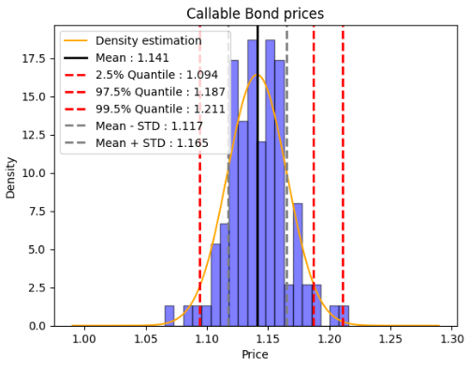
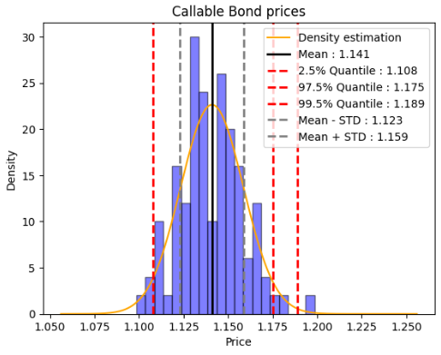
Sans variance reduction | Avec variance reduction

Slide 21
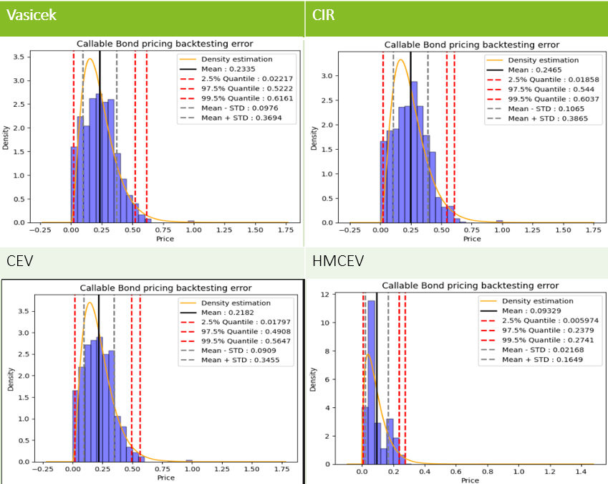
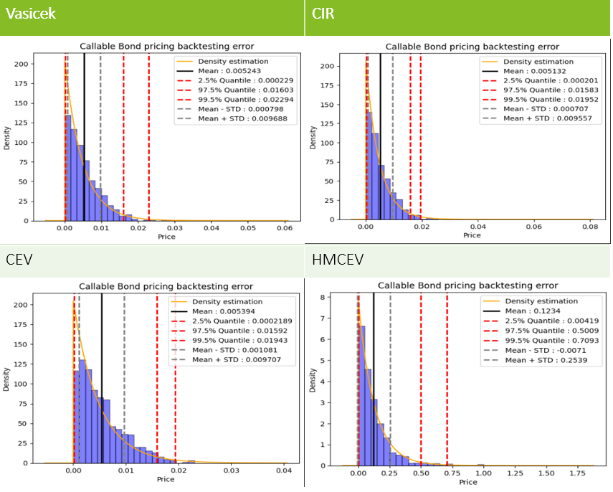

Slide 22
Application à la valorisation des Callable Bonds
Approche : Simulation par Monte Carlo
Construction de la Surface du spread implicite
Performances de valorisation
Application au calcul du SCR de Marché

Slide 23
Vanilla Bond
Key Parameters:
Key Parameters:
Market Value: The current market value of the bond in the portfolio.
Face Value: The face value or par value of the bond, which is the amount the issuer agrees to repay the bondholder at maturity.
Redemption Rate: The ratio of final principal payment / Face value. Most of bonds have a redemption rate of 1.
Time to Maturity: The time remaining until the bond matures, typically expressed in years.
Coupon Rate: The annual coupon rate of the bond, expressed as a percentage of the face value. This defines the periodic coupon payments made to bondholders.
Coupon Frequency: The frequency of coupon payments per year (e.g., semi-annual = 2, quarterly = 4).
currency: The currency of the payments. This would indicate the exchange rate to use to convert bond value in instrument currency to portfolio currency. This also indicate which swap curve and historical interest rate dynamic to use. (See model calibration)
Credit Quality Step: A standardized indicator of Credit Risk. The CQS Credit Rating Scale is based on numbers, ranging from 1 to 6. 1 is the highest quality, 6 is the lowest quality

Slide 24
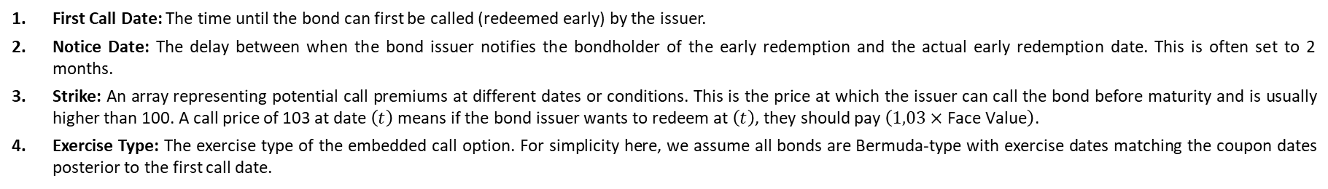
Callable Bond
A callable bond, also known as a redeemable bond, is a bond that the issuer may redeem before it reaches the stated maturity date. A callable bond allows the issuing company to pay off its debt early. A business may choose to call its bond if market interest rates move lower, which allows them to re-borrow at a more advantageous rate. Callable bonds thus compensate investors for this potentiality by typically offering a more attractive interest rate or coupon rate due to their callable nature.
Paramètres supplémentaires:
First Call Date: The time until the bond can first be called (redeemed early) by the issuer.
Notice Date: The delay between when the bond issuer notifies the bondholder of the early redemption and the actual early redemption date. This is often set to 2 months.
Strike: An array representing potential call premiums at different dates or conditions. This is the price at which the issuer can call the bond before maturity and is usually higher than 100. A call price of 103 at date $\left(t\right)$ means if the bond issuer wants to redeem at $\left(t\right)$, they should pay $\left(1,03×\text{Face} \text{Value}\right)$.
Exercise Type: The exercise type of the embedded call option. For simplicity here, we assume all bonds are Bermuda-type with exercise dates matching the coupon dates posterior to the first call date.

Slide 25
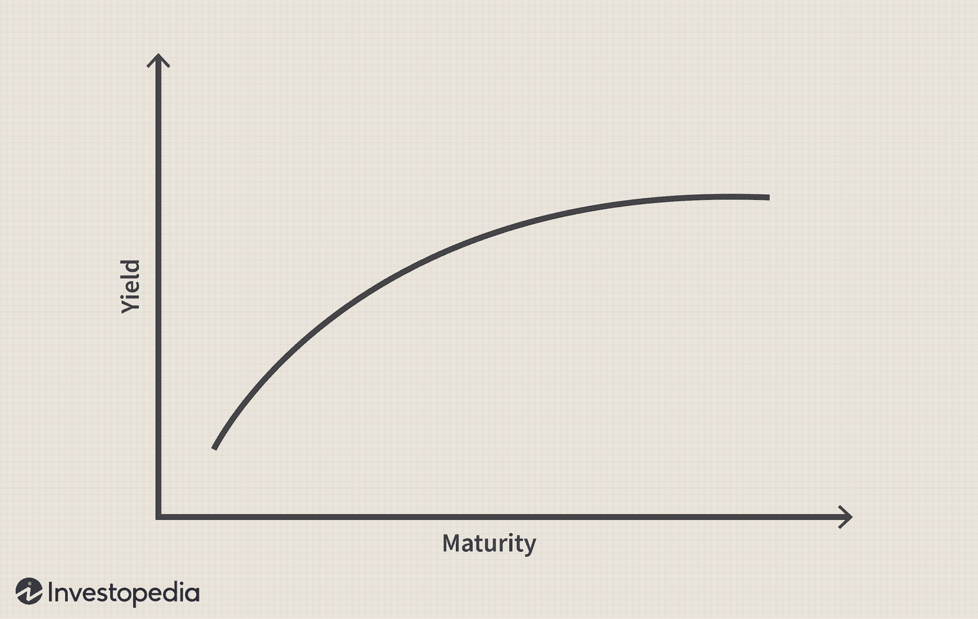

Vanilla Bond price
The present value is the sum of actualized future cashflows.
The actualization use the risk-free yield curve and implied spread. We uses continuous compounding.
For simplification, in the all following, we consider unit bond : Face value = 1.
$$P_{t} =\sum_{i=1}^{f∗T}{\frac{C}{f}e^{−{(Y}_{t,\frac{i}{f}}+IS)i/f}}\text{+ }\text{R}e^{−{(Y}_{t,T}+IS)T}$$
$$Where:$$
$$P : price of the bond$$
$$C\text{ : }\text{Coupon} \text{Rate}$$
$$Y_{t1,t2}:Risk Free Yield for maturity t_{2} at time t_{1}$$
$$f :\text{Coupon} \text{Frequency}$$
$$T :\text{Time} \text{to} \text{Maturity}$$
$$R :\text{Redemption} \text{Rate}.$$
$$IS :Implied Spread$$

Slide 26
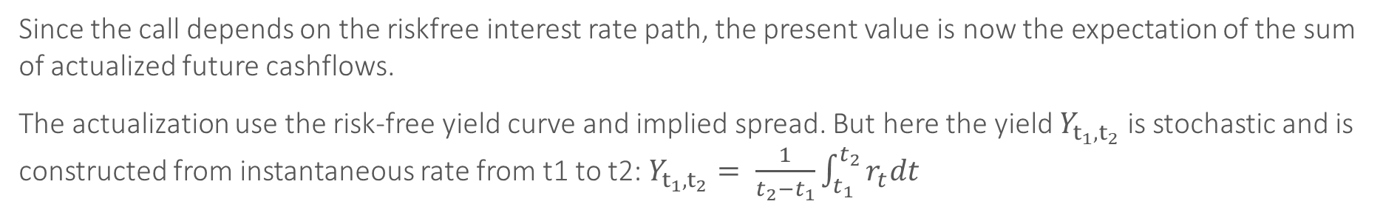

Callable Bond price
Since the call depends on the riskfree interest rate path, the present value is now the expectation of the sum of actualized future cashflows.
The actualization use the risk-free yield curve and implied spread. But here the yield $Y_{t_{1},t_{2}}$ is stochastic and is constructed from instantaneous rate from t1 to t2: $Y_{t_{1},t_{2}}= \frac{1}{t_{2}−t_{1}}\int_{t_{1}}^{t_{2}}{r_{t}dt}$
$$P_{t} =E\left[\begin{aligned}\sum_{i=1}^{f∗T}{1_{t<T_{c}}\frac{C}{f}e^{−{(Y}_{\frac{i}{f}}+IS)i/f}}\text{+ }K_{T_{c}} \\ e^{−{(Y}_{T}+IS)T_c}\end{aligned} ∣ F_{t}\right]$$
$$Where:$$
$$P : price of the bond$$
$$C\text{ : }\text{Coupon} \text{Rate}$$
$$r_{t}:Instantaneous riskfree rate at t$$
$$f :\text{Coupon} \text{Frequency}$$
$$T :\text{Time} \text{to} \text{Maturity}$$
$$T_{c}:\text{Call} \text{time}$$
$$R:\text{Redemption} \text{Rate}.$$
K$:Strike$
$$IS :Implied Spread$$

Slide 27
Modélisation de l’exercice
3 approches candidates
A) Approche naïve α-ajustée : L’émetteur rachète l’obligation lorsque le taux
d’intérêt instantané devient inférieur à α × rc, où α est un paramètre ajusté et
rc est le taux du coupon. Cette méthode est simple mais ignore la dynamique
complète des taux d’intérêt.
B) Approche avancée : Cette méthode évalue le prix de l’obligation comme un
bond classique (sans option de rachat) mais ajoute une option américaine sur le
même bond.
C) Approche d’arbitrage : L’émetteur connaît les évolutions futures des taux
simulés (ce qui est possible, car la fonction de valorisation utilise les taux simulés
jusqu’à la maturité du bond).

Slide 28
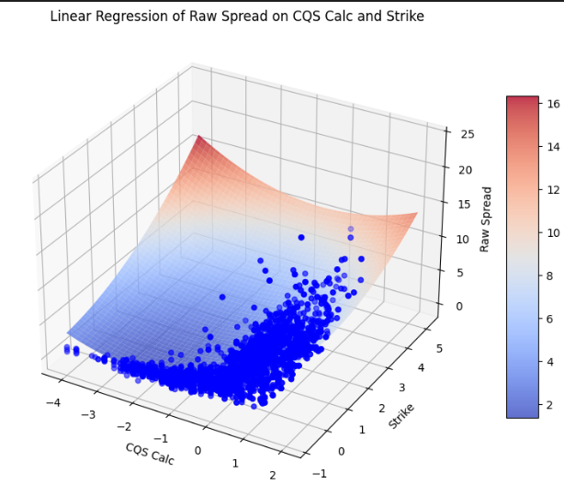
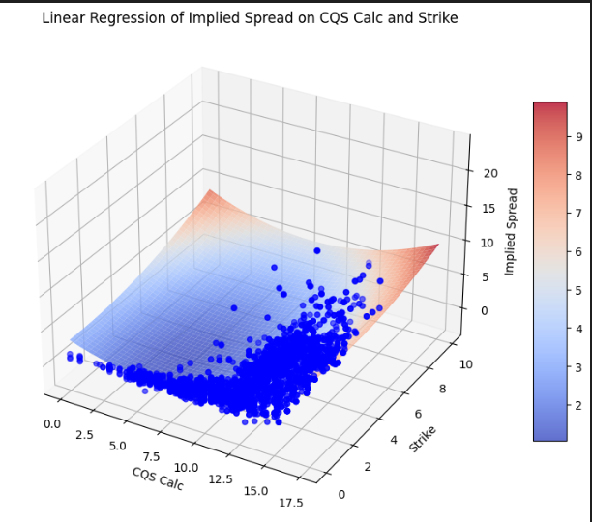
Implied spread surface

Slide 29
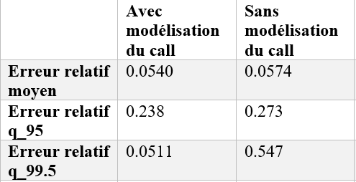

Slide 30
Conclusion

Slide 31
Autres tâches effectuées pendant le stage

Slide 32
- Valorisation des variances swaps
- Optimisation du code pour le calcul des chocs de SCR marché et correction des bugs
- Implémentation des nouveaux chocs pour répondre aux nouveaux besoin client
- Implémentation des unit tests
- Rédaction de la documentation sur la partie calcul de SCR et la partie calcul des durations

Slide 33
Annexes

